Slide 1
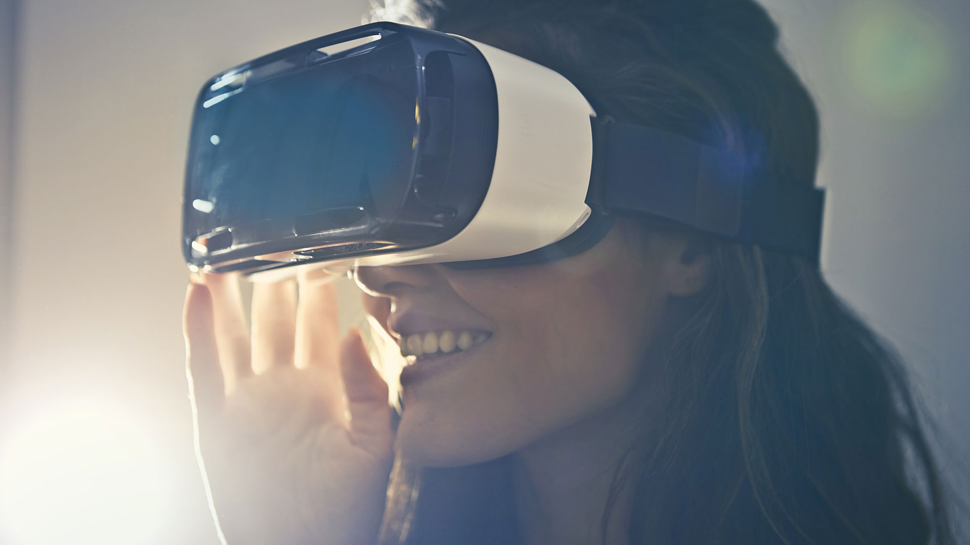
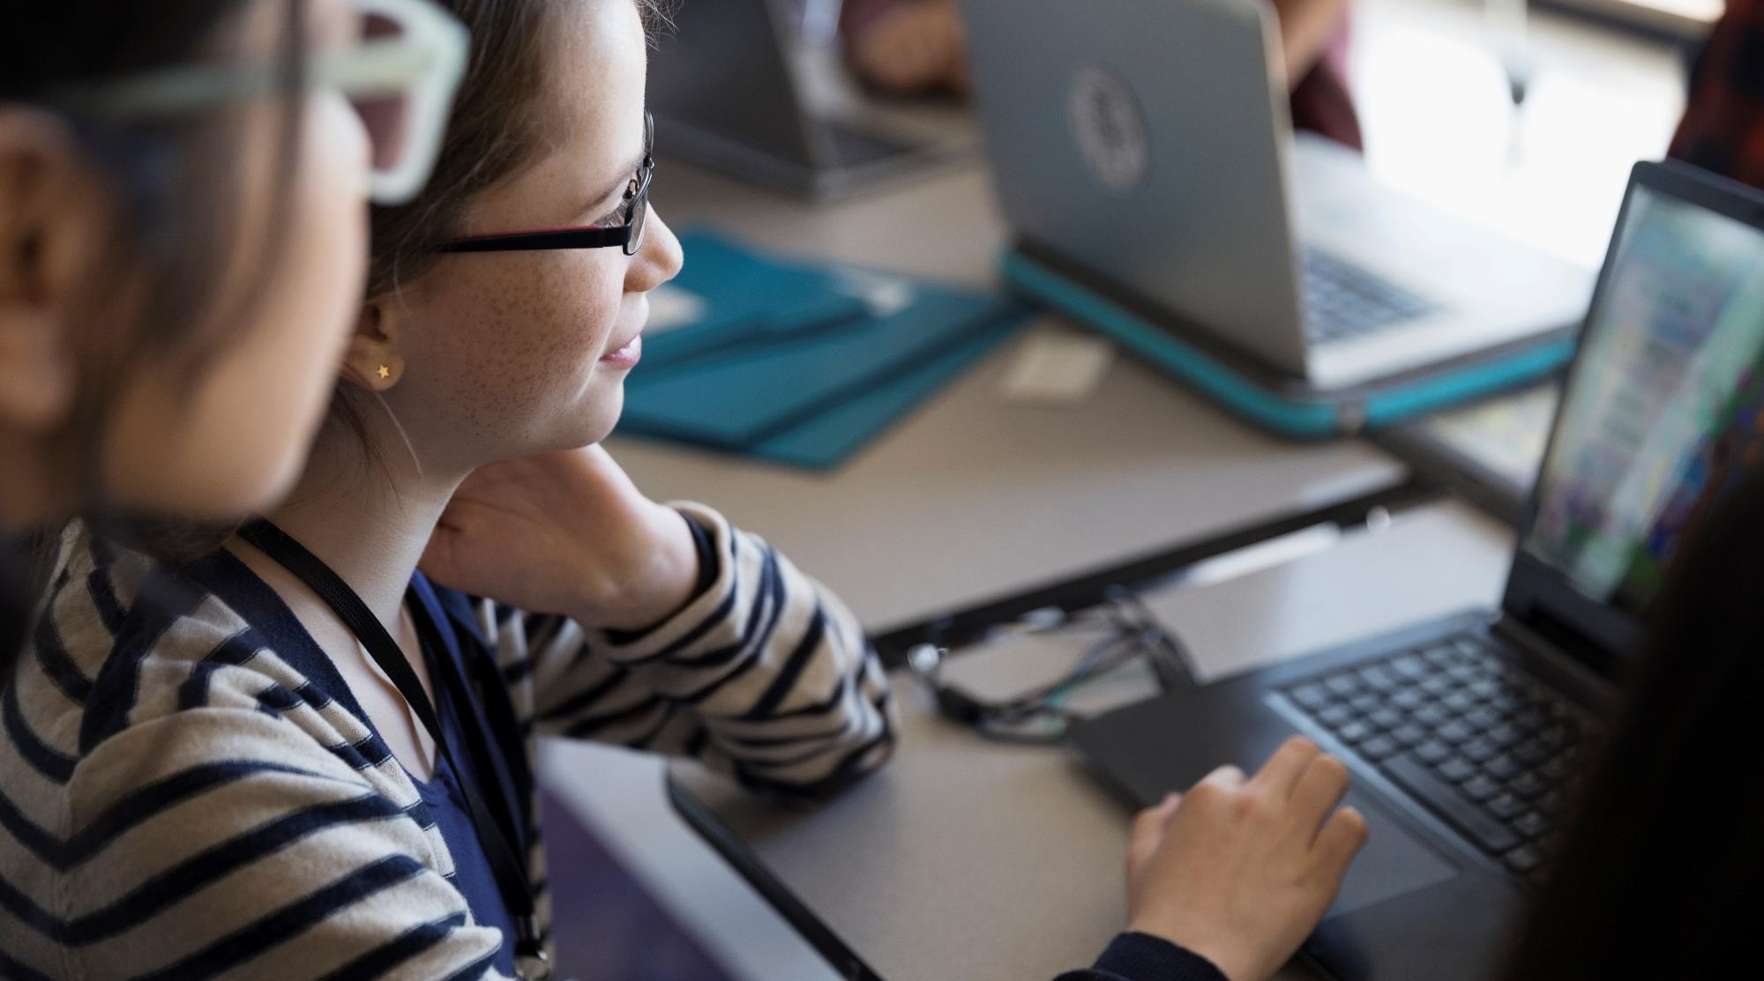

2021-2025 SRMIST KTR
Mars Virtualization
Planetary Players
Index
The Challenge
How it’s different
Our understanding of the Challenge
Visuals
Future Enhancements
6. Submission Links
Space Quest: The Game
Team Members:
Yashwardhan Khanna, Julika,
Sai Kalyan, Dhruv Choudhary

Slide 2
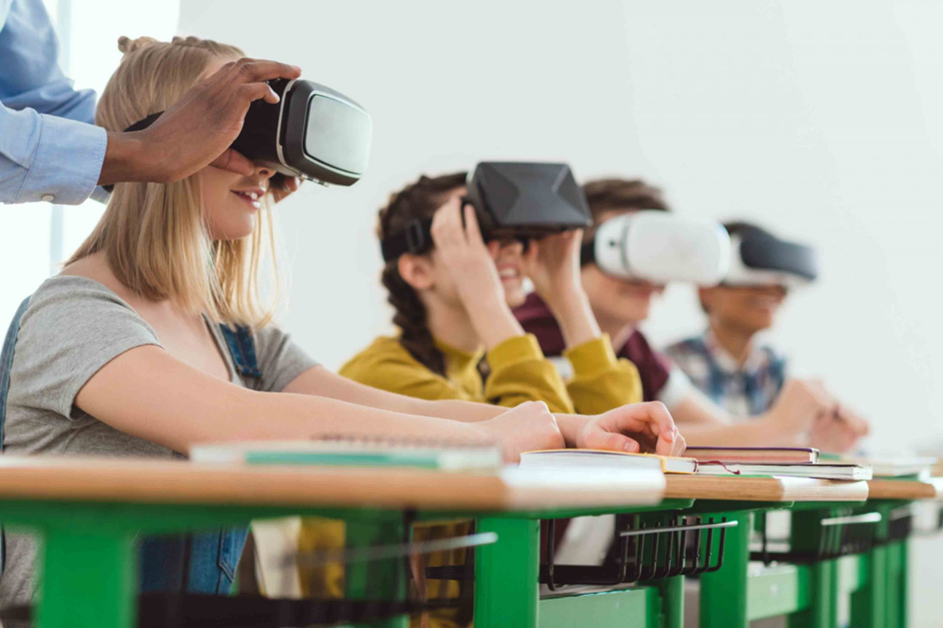
The Problem
The Solution
The solution is to design a project where Space is represented accurately in a 3D environment to make it fun and interesting at the same time.
The project can be used in schools and colleges to provide students the ability to visualize the Martian Surface.
Many educational institutions fail to teach their students about space, which is more effective if taught visually. Not visualizing things make the students less imaginative and prone to loose focus which is not helpful for their learning.
The Space Quest game “Mars Virtualization” is being developed with the help of real NASA 3D models.
The aim of this game is to create awareness in children in an entertaining and in an easy navigational format.

Slide 3
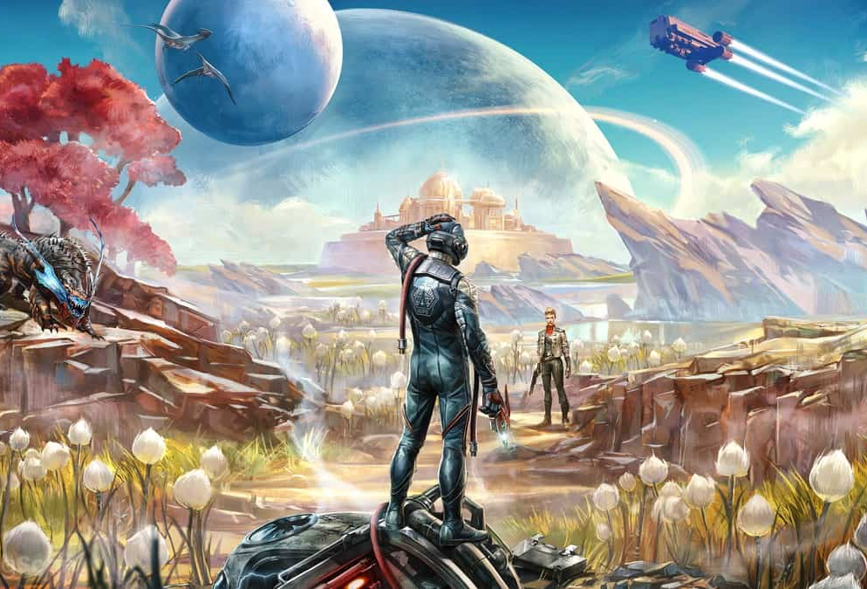



How it’s different?
Unique
Accuracy
It’s unique as it will be educational and entertaining.
The representation of mars is on point.
Expandable
Can be further developed to support VR

Slide 4
Our Understanding of the Challenge
The challenge is to create an Open World game or simulation of Mars which is similar to the red planet and how it will look when humans start colonizing it.
We made our game on Unreal Engine which helped us to create a realistic environment as it is a very powerful game engine.
We also made some conceptual design of Sample Collecting Tools which can be useful during Mars Manned Mission.
The tools include Rake + Scoop and a portable ChemCam.
We made our Mars surrounding with the help of a real image of Mars captured by The Curiosity Rover. We modelled the sample collecting tools in Maya(3D modelling software). We used NASA’s 3D models from their official website.

Slide 5
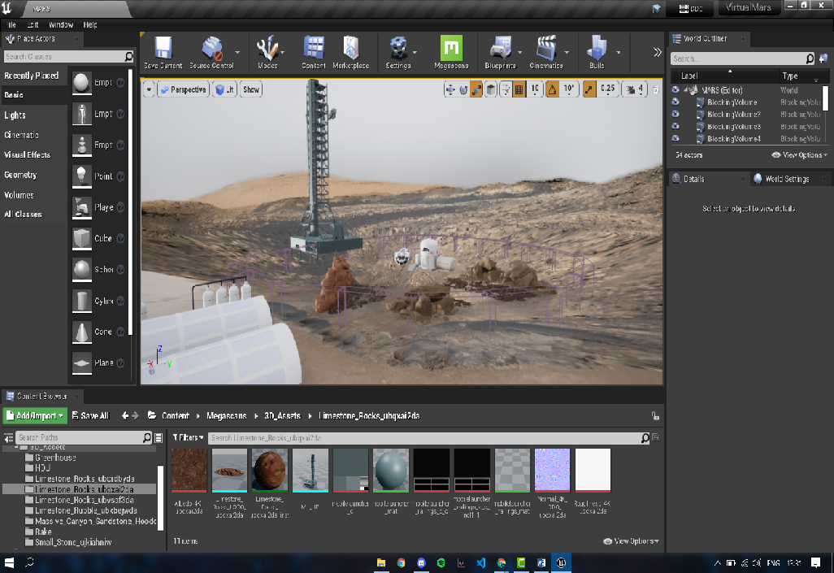
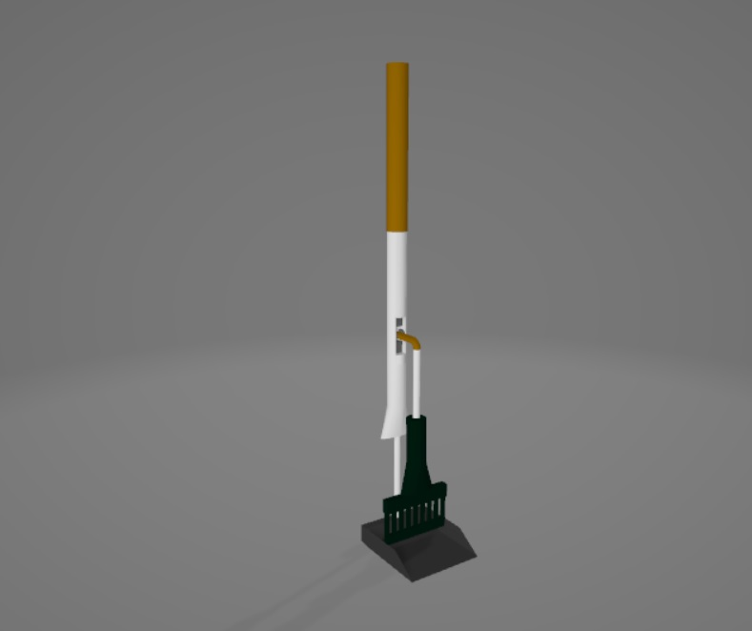
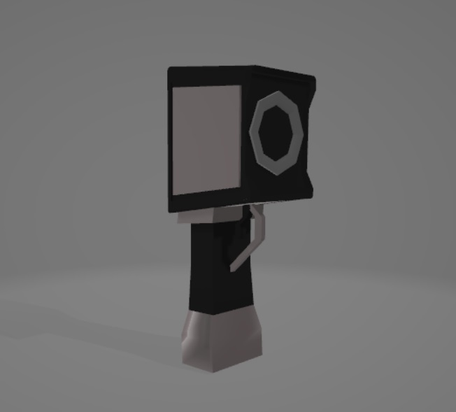
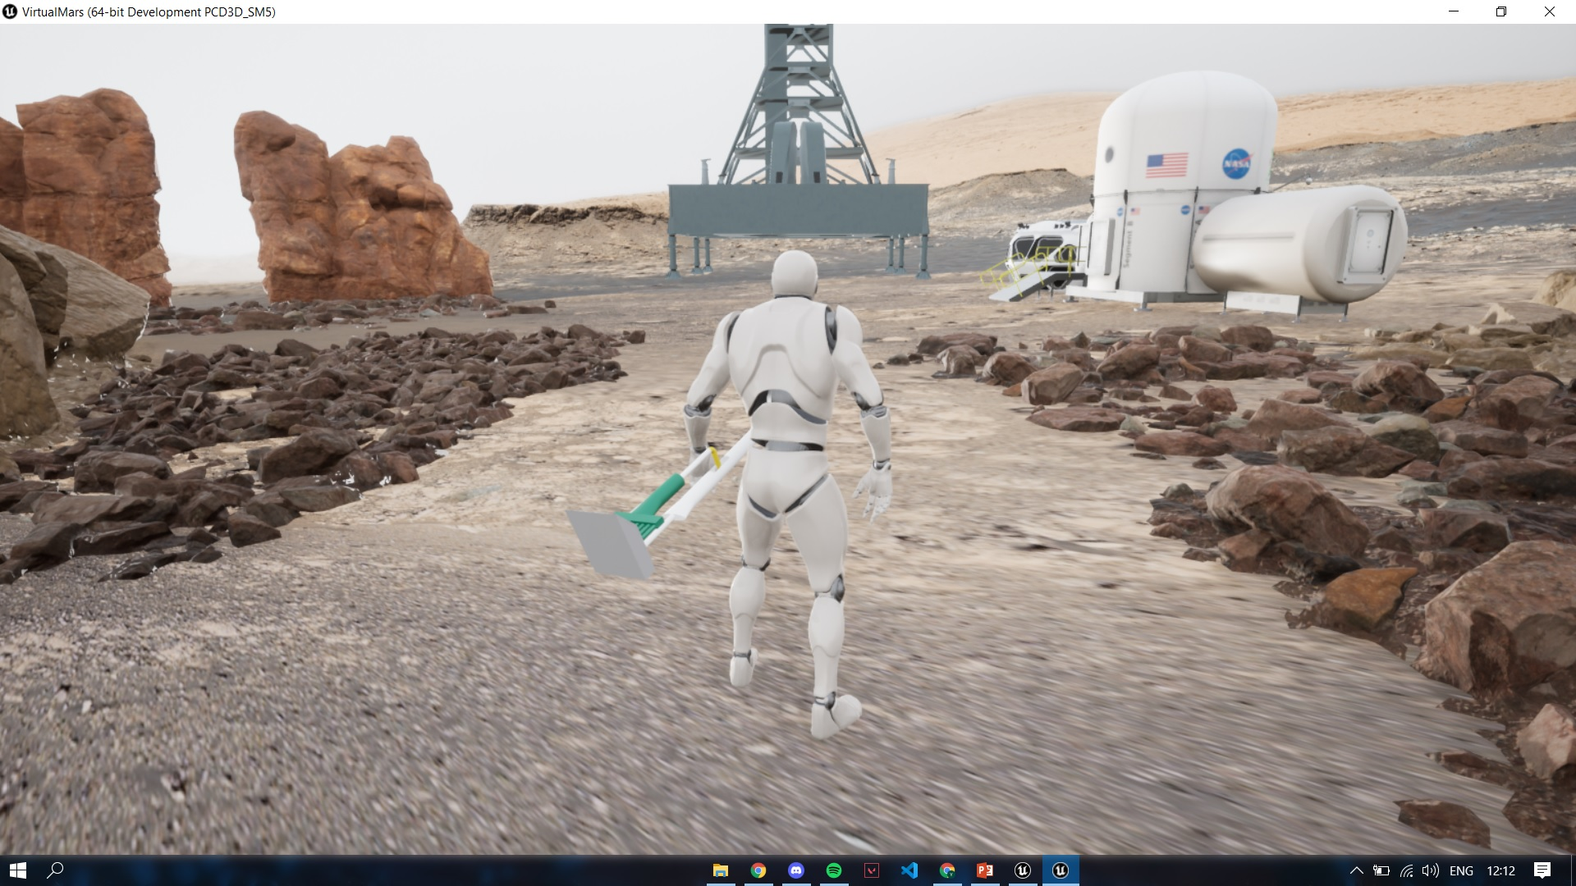
Visuals
Development Phase
Rake and Scoop
ChemCam

Slide 6
Conclusion
Use of Space Agency Data
What do we hope to achieve in future
Hackathon Journey
The 3D background/surrounding is nothing but a 360 degree panoramic view of a real mars image that was taken by the Curiosity Rover.
Every structure like Habitation Module, Portable Launcher, Transportation Rover are all taken from official NASA's 3D resources website.
As currently this project is just a demo and not a full fledged simulator, we really hope that we can make this project real.
We want this project to go open source so that we can expand this project by adding different planets
We can add VR technology which can be used in Training Astronauts so they can get to know what difficulties they can face.
We learnt how to do team work and find a suitable role for each person.
we learnt how to work with unreal engine as this was our first time working with it.
we learnt about Mars Mission and what is going into it.
we learnt how to do research.

Slide 7



Submission Links and Sources
NASA's 3D Models
NASA's curiosity rover Mars Image
NASA's curiosity rover Mars Image
https://mars.nasa.gov/resources/curiositys-1-8-billion-pixel-panorama/?site=msl
https://mars.nasa.gov/resources/curiositys-1-8-billion-pixel-panorama/?site=msl
https://nasa3d.arc.nasa.gov/models
Mars Environment Assets for stones and rubble
Visual Scripting Screenshots and video
https://quixel.com/bridge
https://github.com/SHAY2407/Virtual-Mars
Video Demo Google Drive Link:
https://drive.google.com/file/d/1SswpawwOyphfgiFj6xgoJtj2W2VKCFYY/view?usp=sharing

